Slide 1
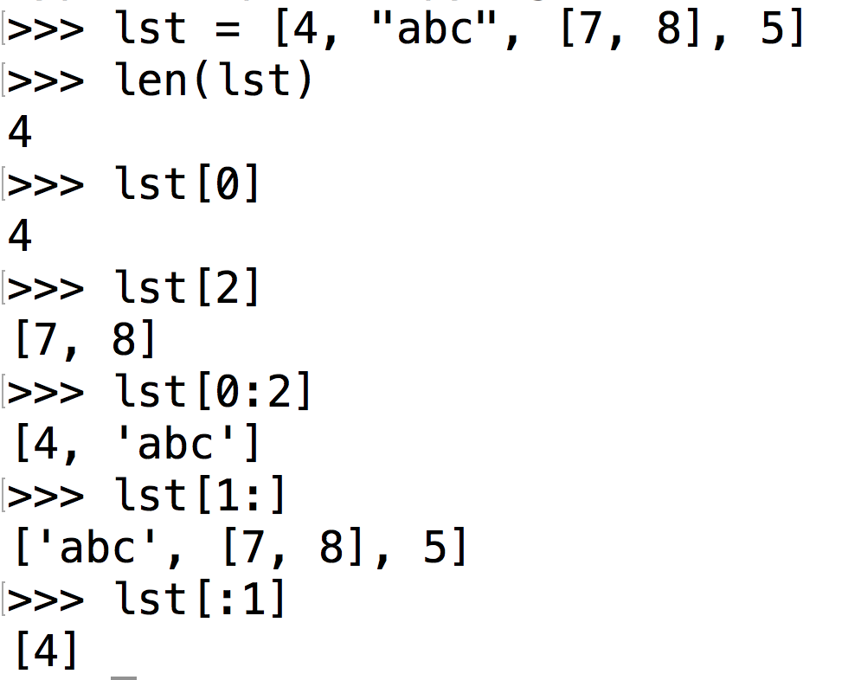
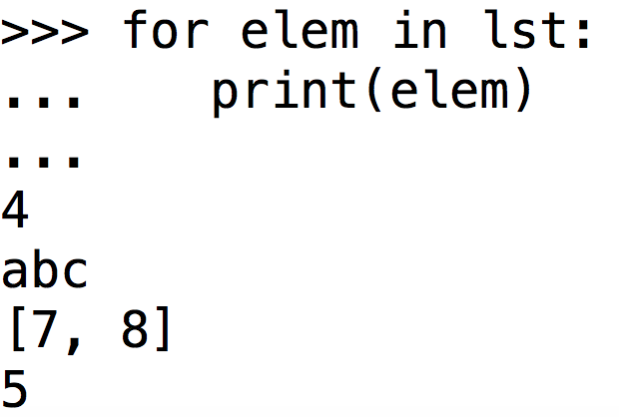
Any questions on lists?
Slices
Loops
Len + indexing
Slices: lst[start:stop]
Goes from start (inclusive)
to stop (exclusive)
Default start: 0,
Default stop: len(lst)
len: number of elements
Indexing: start at 0
for elem in list:
do_something(elem)

Slide 2
Discussion 4:
Data Abstraction & Sequences
Caroline Lemieux (clemieux@berkeley.edu)
February 21st, 2018

Slide 3
Administrativa
Homeworks HW 3 due today (2/21)
Projects Maps Project released and due Thursday 2/28
Optional Hog strategy contest ends Friday 2/22.
Hog composition scores on OK
Other Caroline’s website on the cs61a website! Easy links!

Slide 4
List Comprehensions

Slide 5
[map-expr for name in iter-expr if filter-expr]
(Optional) Filter: get rid of elements that don’t fulfill condition
Map: Applies map expression to each element
Input: an existing list
Output: a new list
[x*x for x in [1, 2, 3, 4, 5] if x % 2 == 1]
Keeps elements where x % 2 == 1
[1, 3, 5]
Squares each element
[1, 2, 3, 4, 5]
[1, 9, 25]

Slide 6
Data Abstraction

Slide 7
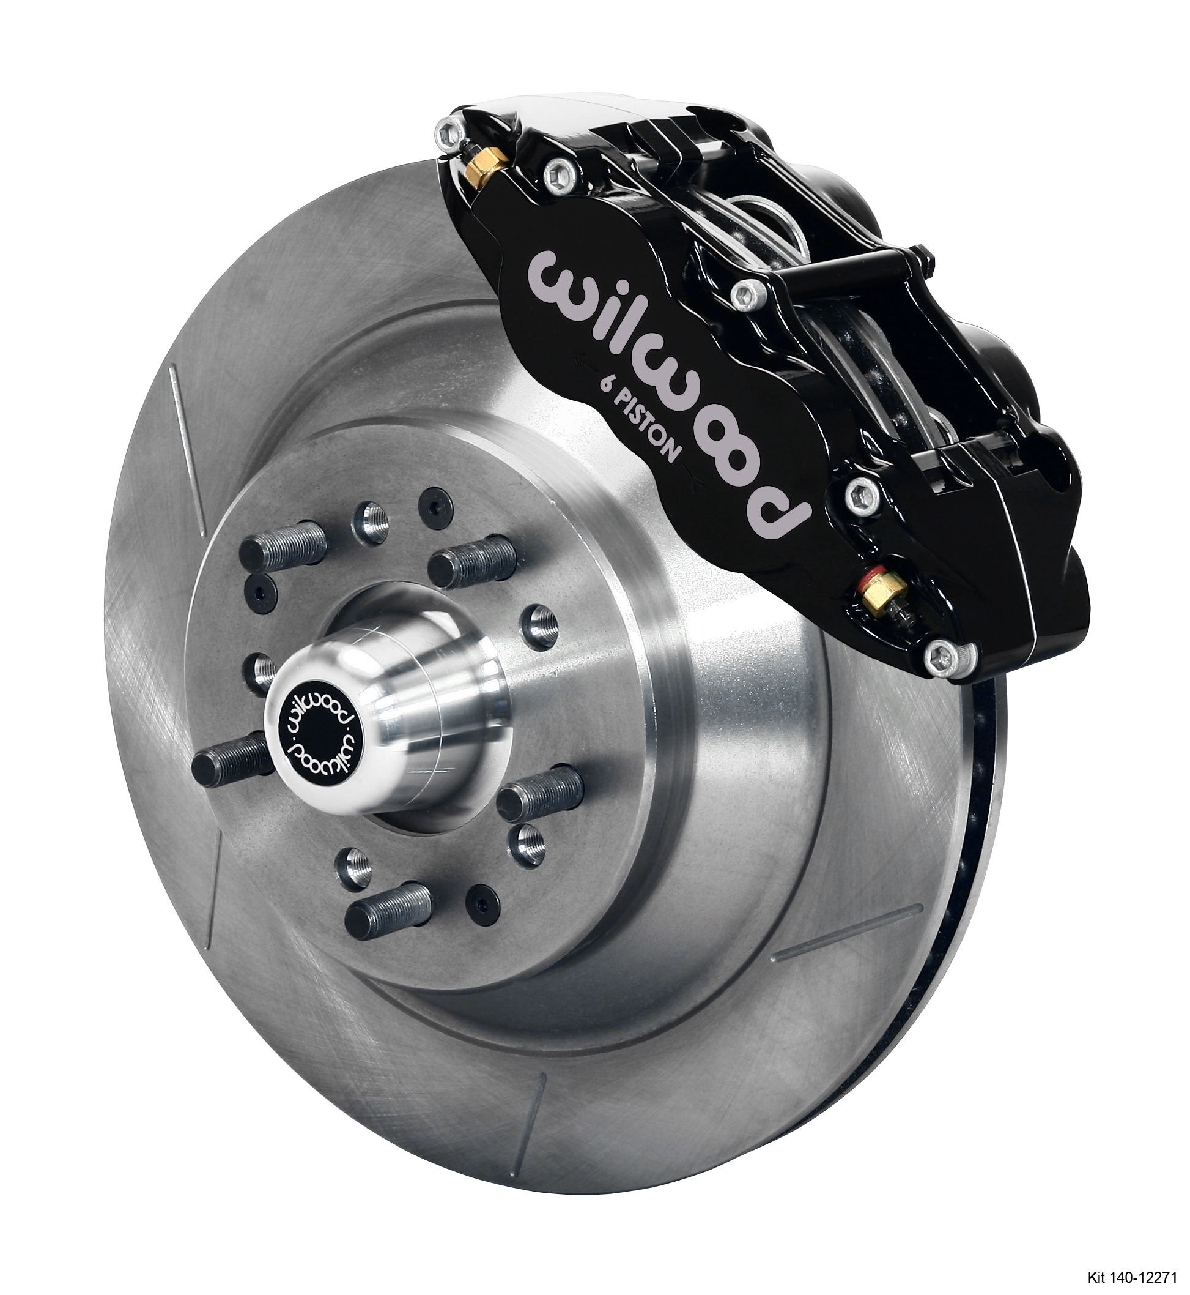


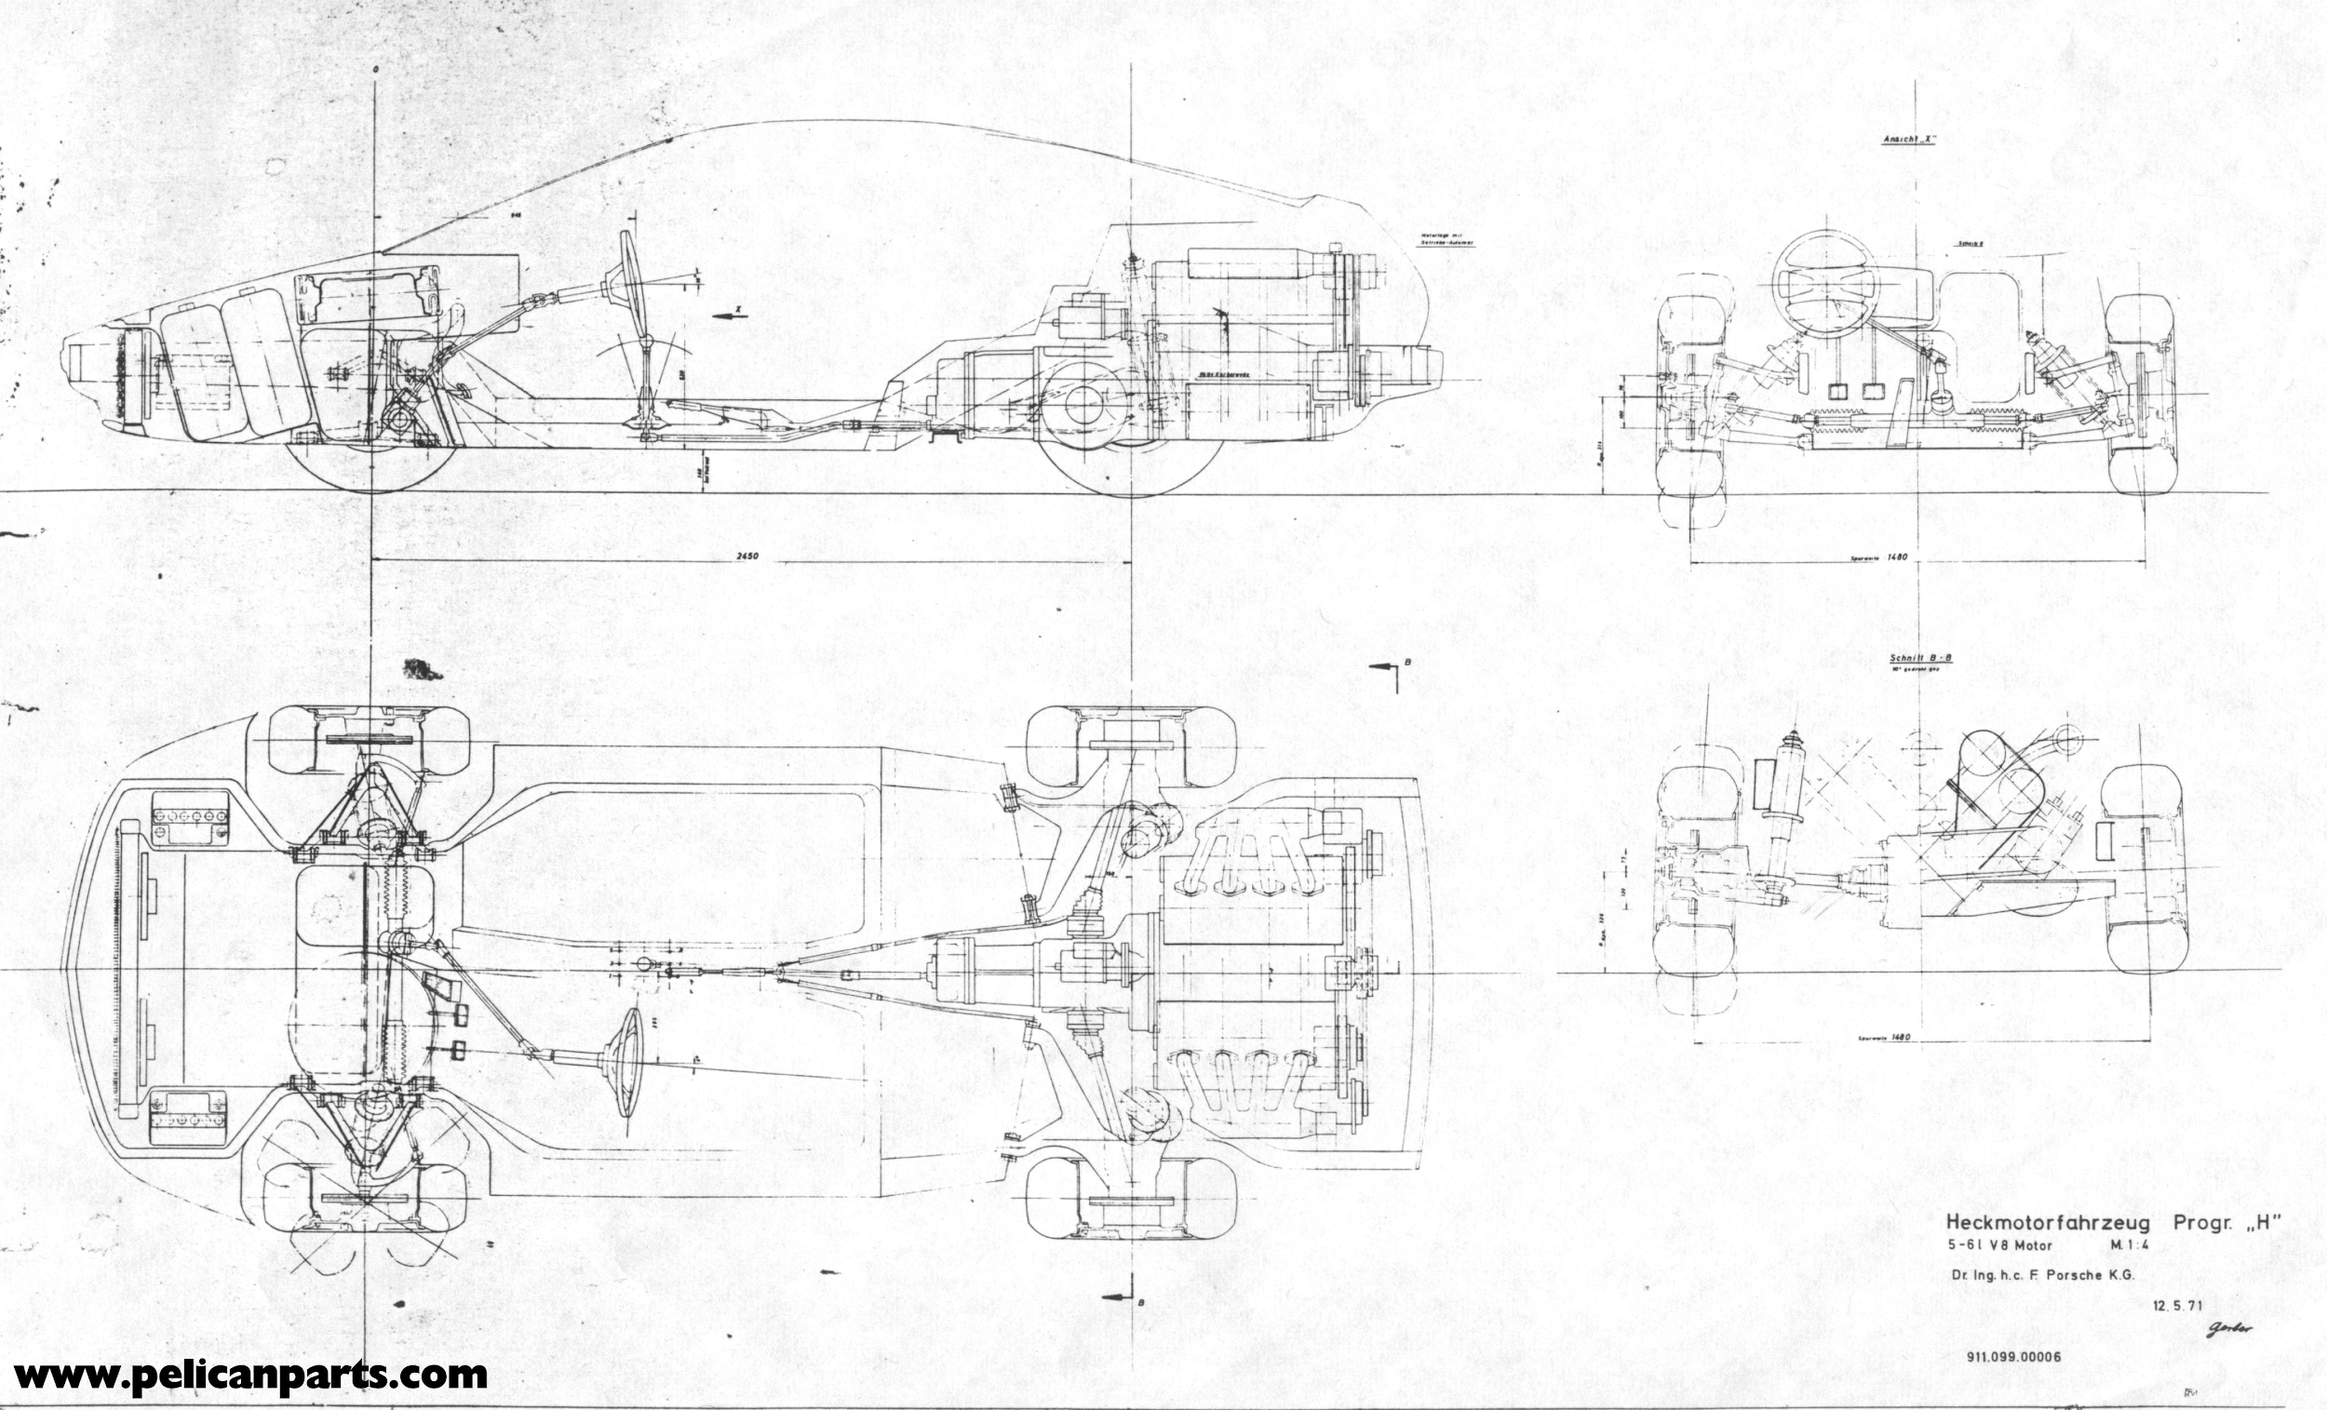


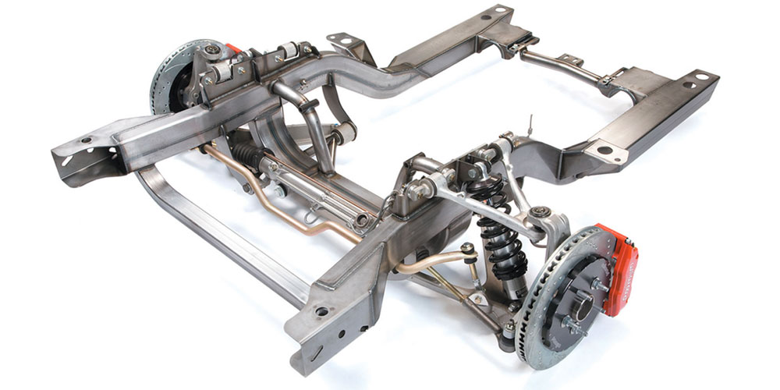
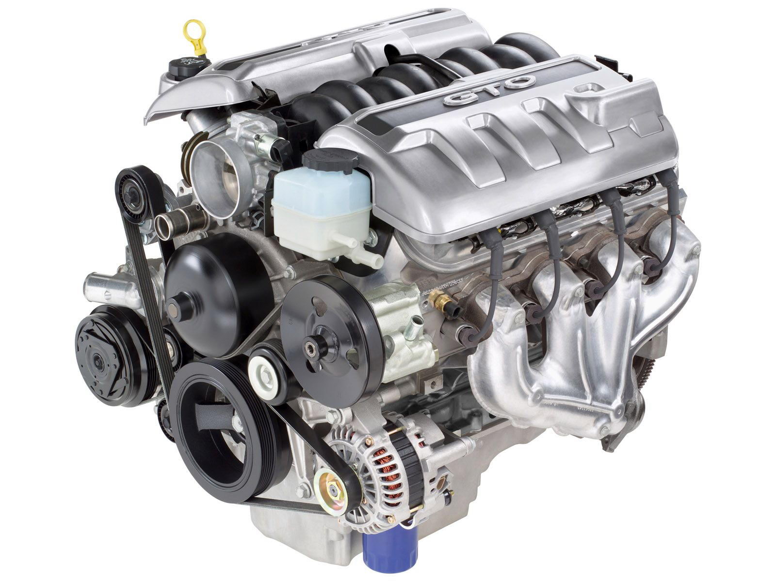
Car abstraction
abstraction barrier
What the car manufacturer sees:
What the end-user sees/uses:

Slide 8
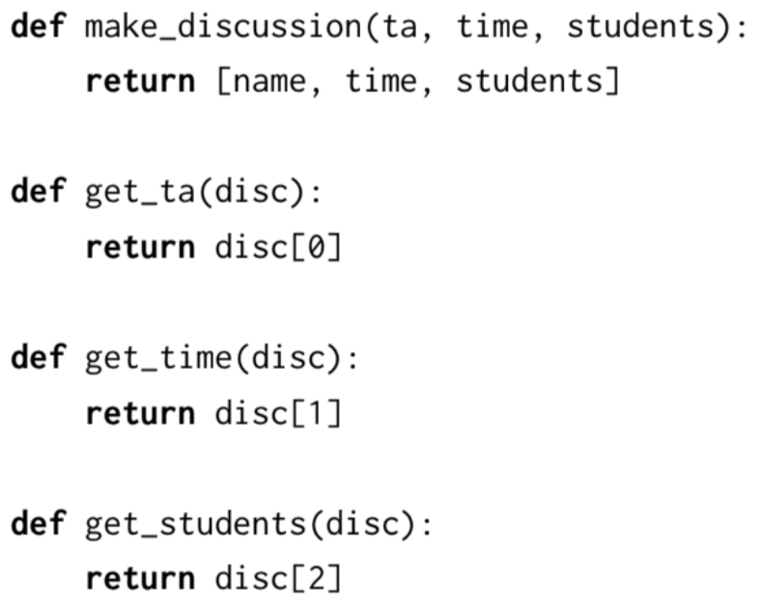
Discussion Section ADT
abstraction barrier
The implementation:
What the end-user sees/uses:
Constructor: make_discussion
Selectors:
get_ta
get_time
get_students
Note: the body (implementation of these functions) is hidden!

Slide 9
Worksheet time

Slide 10
Attendance
links.cs61a.org/caro-disc

Slide 11
Recursion on Lists

Slide 12
Let’s go through a familiar problem...
Write make_zipper, which, given a list of functions [f1, f2, f3] returns a function like
lambda x: f1(f2(f3(x)))
E.g. make_zipper([square, double]) → lambda x: square(double(x))
>>> make_zipper([])
lambda x: x
>>> make_zipper([f1])
lambda x: f1(x)

Slide 13
Let’s go through a familiar problem...
Write make_zipper, which, given a list of functions [f1, f2, f3] returns a function like
lambda x: f1(f2(f3(x)))
E.g. make_zipper([square, double]) → lambda x: square(double(x))
>>> make_zipper([])
lambda x: x
>>> make_zipper([f1])
lambda x: f1(x)
How can we fit lambda x : x here?

Slide 14
Let’s go through a familiar problem...
Write make_zipper, which, given a list of functions [f1, f2, f3] returns a function like
lambda x: f1(f2(f3(x)))
E.g. make_zipper([square, double]) → lambda x: square(double(x))
>>> make_zipper([])
lambda x: x
>>> make_zipper([f1])
lambda x: f1(x)
lambda x: f1((lambda x : x)(x))
How can we fit lambda x : x here?
These are the same!

Slide 15
Skeleton...
def make_zipper(fn_lst):
if lst == []:
return _________________
else:
first_fn = _________________
rest_of_fns = _________________
return _________________

Slide 16
Answer
def make_zipper(fn_lst):
if lst == []:
return lambda x : x
else:
first_fn = lst[0]
rest_of_fns = lst[1:]
return lambda x: first_fn(make_zipper(rest_of_fns)(x))

Slide 17
General format of list-recursive questions
def recurse_on_list(lst):
if lst == []:
return <base_case_value>
else:
first = lst[0]
rest = lst[1:]
return <combine>(first, recurse_on_list(rest))
Typical base case: lst == [] (same as not lst -- why?)
Typical recursive case: Use the first element lst[0], recurse on the rest of the list lst[1:]

